Slide 1
Naloxone in Schools Training For School Staff
Customize this cover slide with your school name, presentation date, school logo, etc., as desired.
Notes:
Notes:
This presentation is intended for training school staff about the drug overdose crisis and the benefits of naloxone, and how to administer it.
Customize this cover slide with your school name, presentation date, school logo, etc., as desired.
Brief, sample discussion points, and notes to presenters are included in this presentation (in notes) in select slides for reference, and may be customized, as needed. This presentation was developed in June 2023.
As some new data are released annually, please review/update slides accordingly to ensure the most up-to-date data/content are presented.

Slide 2
Contents
Scope of the Problem: The Drug Overdose Crisis
Drug Use and Drug Overdose Among Teens
What is Fentanyl?
The Role of Prescription Drugs in the Drug Overdose Crisis
Understanding Opioid Overdoses
Opioid Overdose Reversal Medications
How to Respond to an Opioid Overdose
Good Samaritan Laws
Educational Resources
Questions
Notes:
Discussion Points:
School nurses are leaders in student health and have the education and expertise to assist the community and school leadership in assessing the need for and implementing a campus naloxone program to address drug overdoses in schools and/or in the community. Synthetic opioids like fentanyl have been contributing to increases in drug overdose deaths in the past decade, even among young people. Naloxone is an emergency medication school nurses can administer to save lives by quickly reversing drug overdoses caused by opioids.
In this presentation, we will discuss: [customize to include final list of topics on this contents slide]

Slide 3
Scope of the Problem: The Drug Overdose Crisis

Slide 4
The Drug Overdose Crisis
More than 106,000 persons in the U.S. died from drug-involved overdose in 2021, including illicit drugs and prescription opioids.
Figure1: Statistics by NIDA, 2022 retrieved from https://nida.nih.gov/research-topics/trends-statistics/overdose-death-rates
National Drug-Involved Overdose Deaths*, Number Among All Ages, by Gender, 1999-2021
*Includes deaths with underlying causes of unintentional drug poisoning (X40–X44), suicide drug poisoning (X60–X64), homicide drug poisoning (X85), or drug poisoning of undetermined intent (Y10–Y14), as coded in the International Classification of Diseases, 10th Revision.
(Centers for Disease Control and Prevention [CDC], National Center for Health Statistics [NCHS] 2023)
Notes:
Discussion Points
Drug overdose deaths have greatly increased among young people and other community members over the last decade.
This figure from the National Institute on Drug Abuse highlights the more than 106,000 drug-involved overdose deaths in 2021; these include illicit drugs and prescription opioids.
Content sources:
CDC Wonder – http://wonder.cdc.gov; https://nida.nih.gov/research-topics/trends-statistics/overdose-death-rates
Graphic Source: https://nida.nih.gov/research-topics/trends-statistics/overdose-death-rates

Slide 5
The Drug Overdose Crisis
National Drug-Involved Overdose Deaths*, Number Among All Ages, 1999-2021
*Includes deaths with underlying causes of unintentional drug poisoning (X40–X44), suicide drug poisoning (X60–X64), homicide drug poisoning (X85), or drug poisoning of undetermined intent (Y10–Y14), as coded in the International Classification of Diseases, 10th Revision.
(CDC/NCHS, 2023)
Notes:
Discussion Points
Synthetic opioids, like illegally produced fentanyl, have been driving much of the surge in drug overdose deaths in the past several years. This second figure from the National Institute on Drug Abuse shows the continued increase of deaths from synthetic opioids other than methadone (involving primary fentanyl).
These synthetic opioids may be consumed (knowingly or unknowingly) by young people when mixed into or sold as other drugs like heroin, cocaine, or counterfeit pills. Because a lethal dose of fentanyl can be very small, using drugs contaminated with or replaced by fentanyl can increase the likelihood of an overdose.
We will talk more about synthetic opioids in the coming slides.
Content Sources: CDC WONDER http://wonder.cdc.gov / https://nida.nih.gov/research-topics/trends-statistics/overdose-death-rates
Graphic Source: https://nida.nih.gov/research-topics/trends-statistics/overdose-death-rates

Slide 6
(CDC, 2023a)
Notes:
Discussion Points:
The rise in opioid deaths in America occurred in three distinct waves.
The 1990’s marked a rise in prescription opioid overdose deaths. Next, in 2010, heroin overdose deaths rose. Lastly, in 2013, synthetic opioids such as illicitly made fentanyl resulted in a rise in synthetic opioid overdose deaths
Content source: https://www.cdc.gov/drugoverdose/resources/graphics/overdose.html
Graphic source: https://www.cdc.gov/drugoverdose/resources/graphics/overdose.html (https://www.cdc.gov/drugoverdose/images/21_3_Waves_Graphic_RiseOpioid.png)

Slide 7
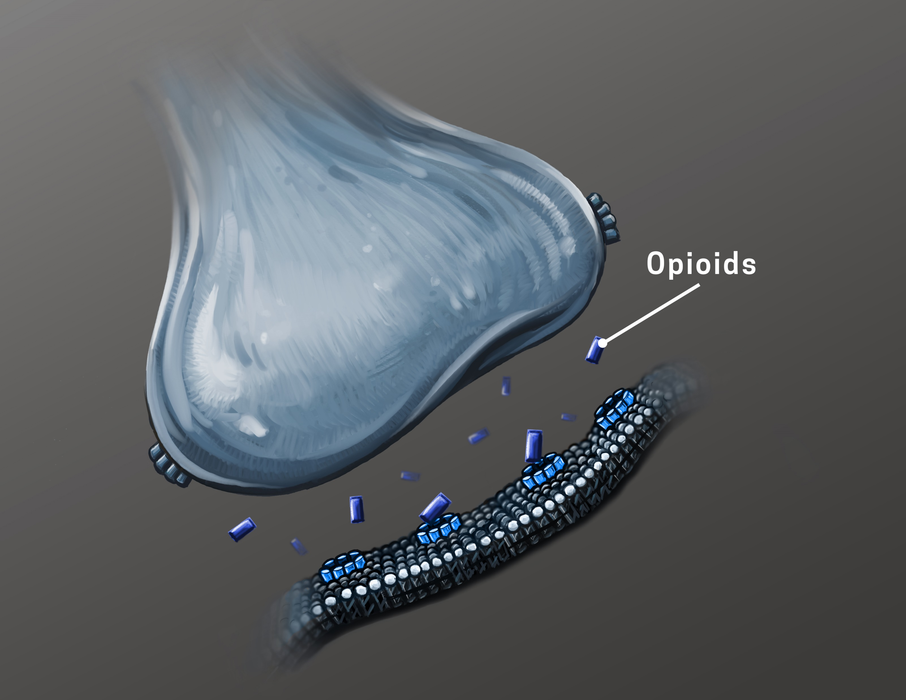
What are opioids?
Opioids bind to receptors in the brain that reduce the body’s perception of pain and create feelings of relaxation and pleasure.
Taking opioids regularly can lead to an opioid use disorder.
Figure 4: From NIDA retrieved from Flickr, https://flic.kr/p/2kcLpWE
Opioids include:
Heroin
Synthetic opioids like fentanyl
Prescription pain medications like codeine, hydrocodone, hydromorphone, meperidine, morphine, oxycodone
(NIDA, 2021)
Notes:
Discussion Points:
Opioids are medications that bind to specific receptors in the brain that reduce the transmission of pain signals throughout the body and create feelings of relaxation and happiness.
Taking opioids regularly can lead to an opioid use disorder.
Opioids are a class of drugs that include heroin, synthetic opioids like fentanyl, and other prescription pain relievers like oxycodone (OxyContin®), hydrocodone (Vicodin®), codeine, morphine, and many others.
Content Sources*:
NIDA, https://nida.nih.gov/research-topics/opioids
NIDA, https://nida.nih.gov/research-topics/commonly-used-drugs-charts#prescription-opioids
NIDA, https://nida.nih.gov/publications/drugfacts/prescription-opioids
*Reminder for NASN—please cite original sources from the NIDA pages listed above, as appropriate
Graphic Source: NIDA Flickr, https://flic.kr/p/2kcLpWE

Slide 8
Medications can help treat opioid use disorder, overdose, and withdrawal
(NIDA, 2021)
Notes:
Discussion Points:
Medications for opioid overdose, withdrawal, and addiction (also known as severe Substance Use Disorder) are safe, effective and save lives.
Naloxone is a life-saving medication that reverses overdose and is available as an emergency nasal spray or injection. Some brand names include Kloxxado®, NARCAN®, and ZIMHI™, and generics are also available.
We will discuss Naloxone in detail later in this presentation.
Content and graphic source: https://nida.nih.gov/research-topics/opioids/medications-opioid-overdose-withdrawal-addiction-infographic

Slide 9
Drug Use and Drug Overdose Among Teens

Slide 10
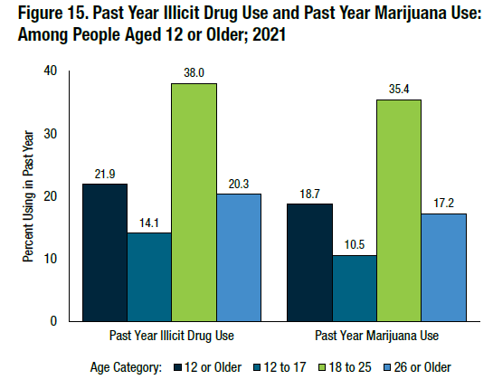
Drug Use Among Young People: Facts & Statistics
3.7 Million Adolescents
(Miech et al, 2023, Substance Abuse and Mental Health Services Administration [SAMSHA] 2023)
Notes:
Discussion Points:
Drug use is a high-profile public health concern among young people, with 14.1% (or 3.7 million) of adolescents aged 12-17 years old reporting past-year illicit drug use in 2021.
Content and graphic source: https://www.samhsa.gov/data/sites/default/files/reports/rpt39443/2021NSDUHFFRRev010323.pdf - PDF page 16
**********************************************************
Additional statistics could be included on this slide:
In 2022, 11% of eighth graders, 21.5% of 10th graders, and 32.6% of 12th graders reported any past-year illicit drug use.
Content sources:
NIDA, https://nida.nih.gov/news-events/news-releases/2022/12/most-reported-substance-use-among-adolescents-held-steady-in-2022
Monitoring the Future, https://monitoringthefuture.org/wp-content/uploads/2022/12/mtf2022.pdf (MTF data tables - 4-2)

Slide 11
Adolescent Overdose Deaths have Increased Dramatically
Overdose deaths have increased among adolescents aged 10-19:
(July – December 2019 to July – December 2021)
109% - median monthly overdose deaths
182% - deaths involving illicitly manufactured fentanyl (IMFs)
90% - deaths involving opioids
84% - deaths involving IMFs
25% - deaths where counterfeit pills were present
(Tainz, et al, 2021)
Overdose can happen to anyone! Only 35% of the young people who died had a known history of opioid use.
Notes:
Discussion Points:
This slide shows how much overdose deaths have increased among teens aged 10-19 years old.
A large takeaway from this slide is that overdose can happen to anyone! Only 35% of the young people who died had a known history of opioid use.
Content source: Tanz LJ, Dinwiddie AT, Mattson CL, O’Donnell J, Davis NL. Drug Overdose Deaths Among Persons Aged 10–19 Years — United States, July 2019–December 2021. MMWR Morb Mortal Wkly Rep 2022;71:1576–1582. DOI: http://dx.doi.org/10.15585/mmwr.mm7150a2.

Slide 12
What is Fentanyl?

Slide 13
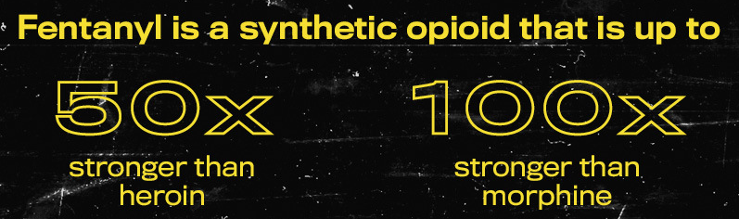
Figure 8: CDC, 2023 retrieved from https://www.cdc.gov/stopoverdose/fentanyl/index.html
One of the most common drugs involved in drug overdose deaths in the United States.
Can be prescribed but is also made illegally.
Inexpensive to manufacture.
Can be mixed with other drugs (i.e., heroin, cocaine, meth, pressed pills); a person may not know that it’s been added, leading them to underestimate how much opioids they are taking and increase chance of overdose.
It is almost impossible to know whether a drug contains fentanyl.
Test strips can help determine if fentanyl is present in a drug.
Naloxone can reverse a drug overdose from opioids, including fentanyl.
(CDC, 2022; 2023a; NIDA, 2021)
Notes:
Discussion Points:
Fentanyl is a very powerful synthetic opioid
It is one of the most common drugs involved in drug overdose deaths in the United States
It can be prescribed but is also made illegally.
It is inexpensive to manufacture because its components are easy to get and are concentrated
It can also be mixed with other drugs (i.e., heroin, cocaine, meth, pressed pills); a person may not know that it’s been added, leading them to underestimate how much opioids they are taking and increase chance of overdose.
It is almost impossible to know whether a drug contains fentanyl without special equipment—like fentanyl test strips. Fentanyl is colorless, tasteless and odorless.
But remember, naloxone can stop a drug overdose from opioids, including fentanyl.
Content source:
https://nida.nih.gov/publications/drugfacts/fentanyl
https://www.cdc.gov/stopoverdose/fentanyl/index.html
https://www.cdc.gov/stopoverdose/fentanyl/fentanyl-test-strips.html
Image source: https://www.cdc.gov/stopoverdose/fentanyl/index.html

Slide 14
Fentanyl mixed into other drugs is a driver of teen overdose deaths
Counterfeit pills:
Resemble prescription drugs
Have become more common
Have increased fatal overdose risk among teens
Are easy to buy online
Were involved in nearly 25% of overdose deaths from 2019 to 2021 (CDC, 2023)
Retrieved from Flipboard.com
Notes:
Discussion Points:
Counterfeit pills that resemble prescription drugs but contain illicitly manufactured fentanyl have become more common and have increased fatal overdose risk among teens, in part due to the ease of purchasing these pills online.
Remember the statistics from a few slides back:
84% overdose deaths among teen (10–19 years old) involved illicitly manufactured fentanyl (July – December 2019 to July – December 2021).
Counterfeit pills were involved in nearly 25% of overdose deaths. (July – December 2019 to July – December 2021)
Content Source: https://www.cdc.gov/mmwr/volumes/71/wr/mm7150a2.htm

Slide 15
Too much of any opioid, including prescription opioids or illicitly manufactured opioids, leads to slowed breathing, resulting in too little oxygen reaching the brain—known as hypoxia.
Hypoxia can lead to coma, permanent brain damage, or death.
(NIDA, 2021)
Notes:
Discussion Points:
It is vital to understand that an opioid overdose (either from prescribed medications or illicitly manufactured) decreases respirations and if not reversed, will cause death quickly. The body does not differentiate if the drug came from a prescription or from illicitly manufactured opioids, such as heroin. An opioid is an opioid.
Opioid misuse can cause slowed breathing, which can cause hypoxia, a condition that results when too little oxygen reaches the brain. Hypoxia can have short- and long-term psychological and neurological effects, including coma, permanent brain damage, or death.
Content Source: https://nida.nih.gov/publications/drugfacts/prescription-opioids

Slide 16
Understanding Opioid Overdoses

Slide 17
What Is an Opioid Overdose?
Someone is exposed a dose of opioids too strong for their body to process
Slow breathing or no breathing
Hypoxia (not enough oxygen getting to the brain)
Psychological/neurological effects, coma, permanent brain damage, or death
(NIDA, 2021a)
Notes:
Content source: https://nida.nih.gov/publications/drugfacts/prescription-opioids
Image source:ambulance-stands-outside-modern-hospital-doctor-home-call-health-care-concept_189498-962.jpg (626×396) (freepik.com)

Slide 18
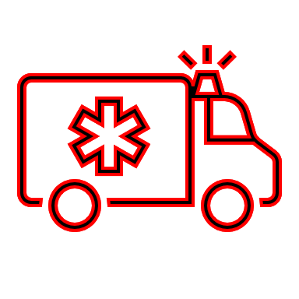
Opioid Intoxication vs. Opioid Overdose
Call 911 immediately!
Opioid Intoxication | Opioid Overdose
Relaxed muscles | Pale, clammy skin
Slowed or slurred speech, slowed or shallow breathing | Speech infrequent, not breathing, very shallow breathing
Appears sleepy | Deep snorting or gurgling
Responds to stimuli (shaking, sternal rub) | Unconscious and unresponsive to stimuli (calling name, shaking, sternal rub); limp body
Normal heart rate/pulse | Slowed heart rate/pulse
Normal skin color | Cyanotic skin coloration (blue lips, fingertips)
(CDC, 2023f; Massachusetts Department of Public Health, nd)
Notes:
Discussion Points:
It is also important to recognize the signs of an overdose.
Understanding the difference between opioid intoxication and opioid overdose can be life-saving.
If you see a person exhibiting symptoms of an opioid overdose, call 911 for help immediately.
Content sources:
https://www.mass.gov/doc/core-competencies-for-intra-nasal-naloxone-distribution-pilot-program-participants/download
https://www.cdc.gov/drugoverdose/pdf/patients/Preventing-an-Opioid-Overdose-Tip-Card-a.pdf

Slide 19
Who is at risk of an opioid overdose?
Anyone who uses drugs is at risk of an overdose.
(NIDA, 2021b)
Notes:
Discussion Points:
Anyone who uses drugs is at risk of an overdose. This is in large part due to fentanyl and other synthetic opioids being mixed with illegal drugs, such as cocaine, heroin, methamphetamine, and MDMA.
According to the National Institute on Drug Abuse, “This is especially dangerous because people are often unaware that fentanyl has been added. The high potency of fentanyl greatly increases risk of overdose, especially if a person who uses drugs is unaware that a powder or pill contains it. They can underestimate the dose of opioids they are taking, resulting in overdose.”
Content source: https://nida.nih.gov/publications/drugfacts/fentanyl

Slide 20
Opioid Overdose Reversal Medications

Slide 21
Learn About Naloxone
Naloxone:
Is a life-saving medication that restores normal breathing
Rapidly reverses an overdose from opioids (e.g., heroin, fentanyl, and prescription opioid medications) when given in time
Only works for 30-90 minutes; multiple doses may be needed, and emergency medical care should be sought even if overdose symptoms resolve
There are two forms of naloxone:
Nasal spray
Injectable
The NARCAN brand nasal spray was approved for non-prescription use in 2023.
Anyone can administer naloxone. Medical training or authorization is NOT required.
(CDC, 2023b; FDA, 2023; NIDA2023a)
Notes:
Discussion Points:
Naloxone is a life-saving medication that can rapidly reverse an overdose from opioids—including heroin, fentanyl, and prescription opioid medications—when given in time.
According to the National Institute on Drug Abuse, “Naloxone can quickly restore normal breathing to a person if their breathing has slowed or stopped because of an opioid overdose. Naloxone only works in the body for 30 to 90 minutes. It is possible for a person to still experience the effects of an overdose after naloxone wears off or need multiple doses if a potent opioid is in a person’s system.”
There are 2 forms of naloxone that anyone can use without medical training or authorization--a nasal spray and injectable.
Injectable brands of naloxone are typically drawn up from a vial, though one brand offers a prefilled syringe. Naloxone is usually injected into muscle.
Naloxone is available in all 50 states
In 2023, the U.S. Food and Drug Administration approved NARCAN, 4 milligram (mg) naloxone hydrochloride nasal spray for over-the-counter (OTC), nonprescription, use.
Note that NARCAN is not the only formulation and brand name for naloxone; however, many people incorrectly still refer to all naloxone products as “NARCAN.”
Anyone can administer naloxone; no formal training is required. Instructions for use are included with each dose in the packaging, and should be followed for proper administration.
Content sources:
https://www.cdc.gov/stopoverdose/naloxone/index.html
https://www.fda.gov/news-events/press-announcements/fda-approves-first-over-counter-naloxone-nasal-spray
https://nida.nih.gov/publications/drugfacts/naloxone
Graphic source:
https://www.cdc.gov/stopoverdose/naloxone/index.html

Slide 22
Naloxone is Safe to Use
Naloxone is the first line treatment for opioid overdose.
While naloxone does not reverse overdoses caused by tranquilizers (e.g., xylazine), stimulants, and other classes of drugs, naloxone should still be given if drug overdose is suspected in case opioids may be involved.
Naloxone is a safe drug.
If the person has not overdosed on an opioid, naloxone has no effect on the body!
The risk of death from an opioid overdose is much greater than the risk of side effects from naloxone.
There are virtually no adverse health effects from naloxone.
(CDC, 2023b; FDA, 2023; NIDA, 2023e)
Notes:
Discussion Points:
Naloxone is the first line treatment for opioid overdose
Parents & school administrators should not be concerned about adverse health effects of naloxone
The risk of death from an opioid overdose is much greater than the risk of adverse health effects from naloxone.
If the person has not overdosed on an opioid, naloxone has no effect on the body!
Naloxone should always be given in suspected cases of overdose with tranquilizers, benzodiazepines, or stimulants because they are frequently combined with opioids; however, naloxone will only reverse the effects of opioid overdose.
It’s important to note that xylazine has been linked more and more to opioid overdose deaths as people are consuming it – knowingly or unknowingly—when it is added to illicit opioids. It is recommended to administer naloxone to reverse the effects of the opioid, though the effects from xylazine on breathing will not be reversed by naloxone.
Content Sources*:
https://www.cdc.gov/stopoverdose/naloxone/index.html; primary: https://store.samhsa.gov/sites/default/files/d7/priv/sma18-4742.pdf
https://nida.nih.gov/publications/drugfacts/naloxone
https://www.fda.gov/drugs/drug-safety-and-availability/fda-alerts-health-care-professionals-risks-patients-exposed-xylazine-illicit-drugs
https://nida.nih.gov/research-topics/xylazine
*Reminder for NASN—please cite original sources, as appropriate
Image Source:
https://www.cdc.gov/stopoverdose/naloxone/index.html

Slide 23
Naloxone Should Be Given as Soon as Possible
Naloxone should be administered IMMEDIATELY.
After administering naloxone, the responder (e.g., school nurse) should stay with the person until emergency help arrives.
(CDC, 2023B; FDA, 2023)
Notes:
Discussion Points:
It should be administered IMMEDIATELY
After administering naloxone, the responder should stay with the person until emergency help arrives or for at least four hours to make sure their breathing returns to normal.
Content Sources*:
https://www.cdc.gov/stopoverdose/naloxone/index.html; primary: https://store.samhsa.gov/sites/default/files/d7/priv/sma18-4742.pdf
*Reminder for NASN—please cite original sources, as appropriate
Image Source:
https://www.cdc.gov/stopoverdose/naloxone/index.html

Slide 24
Debunking Naloxone Myths
Myth: Naloxone encourages people who use substances to use more drugs.
Myth: Naloxone prevents people who use substances from seeking treatment.
Myth: Only doctors can give naloxone.
Fact: Research shows that naloxone doesn’t lead to more or riskier drug use; some research even shows that naloxone can result in reduced opioid use.
Fact: There is no evidence to support that naloxone prevents people who use substances from seeking treatment. Near-death experiences, like overdose, can often be a catalyst to seeking treatment and recovery.
Fact: Naloxone is available in all 50 states. Anyone can purchase/carry naloxone nasal spray without having to obtain a prescription. In the event of an overdose, anyone can save a life by giving naloxone.
(Jones, J.D.,et al, 2017; Wagner, K.D. et al, 2010; Bazazi, A.R. et al, 2010)
Notes:
Content sources:
1. Jones, J. D., et al. “No Evidenceof Compensatory Drug Use Risk Behavior among Heroin Users after Receiving Take-Home Naloxone.” Addictive Behaviors, vol. 71, 2017, pp. 104–106.
2. Wagner, K. D., et al. “Evaluationof an Overdose Preventionand Response Training Programme for Injection Drug Users inthe Skid Row Areaof Los Angeles, CA.” International Journal
of Drug Policy, vol. 21,no. 3, 2010, pp. 186–193.
3. Bazazi, A.R. et al. “Preventing Opiate Overdose Deaths: Examining Objections to Take-Home Naloxone” Journal of Health Care for the Poor and Underserved, vol. 21,no. 4, 2010.
https://www.cdc.gov/stopoverdose/naloxone/index.html
https://www.cdc.gov/stopoverdose/naloxone/faq.html#addictive

Slide 25
How to Respond to an Opioid Overdose
Recognize Respond Reverse Respirations Refer
Notes:
Discussion Point:
In this section, we will cover the necessary steps to respond to an opioid overdose. Remember to follow the five Rs – recognize, respond, reverse, respirations, and refer.
Note: The steps to responding to an overdose are also explained in detail in the Naloxone Administration Protocol found in the NASN Naloxone toolkit.

Slide 26
How to Respond to an Overdose: Recognize Respond Reverse Respirations Refer
Figure 17: Picture oa life saver ring in water retrieved fromhttps://blog.disabilitycanhappen.org/how-to-build-an-emergency-fund/
Notes:
Discussion Point:
The first step is to RECOGNIZE the signs to determine the proper response.

Slide 27
Recognize the signs
Small, constricted “pinpoint pupils”
Falling asleep or loss of consciousness
Slow, shallow breathing
Choking or gurgling sounds
Limp body
Pale, blue, or cold skin
(CDC, 2023b)
Notes:
Discussion Point:
Observe individual for signs and symptoms of opioid poisoning, including:
Respiratory depression evidenced by slow respirations or no breathing (apnea)
Loss of consciousness or unresponsiveness to stimuli (such as calling name, shaking, sternal rub)
Other signs and symptoms may include:
Small constricted or pinpoint pupils
Choking or gurgling sounds
Limp body
Pale, blue, or cold skin
Content source: https://www.cdc.gov/drugoverdose/pdf/patients/Preventing-an-Opioid-Overdose-Tip-Card-a.pdf

Slide 28
How to Respond to an Overdose: Recognize Respond REVERSE Respirations Refer
Figure 19: Picture of a life saver ring in water retrieved fromhttps://blog.disabilitycanhappen.org/how-to-build-an-emergency-fund/
Notes:
Discussion Point:
Once you’ve identified the signs of an overdose, you must RESPOND immediately.

Slide 29
Respond by Calling for Help Immediately
Call for help – Dial 911.
Request advanced life support.
Tell the dispatcher that someone is unresponsive and not breathing
Provide the dispatcher with your address or location.
(SAMSHA, 2023a)
Notes:
Discussion Points:
An essential step is to get someone with medical expertise to see the person as soon as possible. If no emergency medical services (EMS) or other trained personnel is on the scene, activate the 911 emergency system immediately. All you have to say is “Someone is unresponsive and not breathing.”
Be sure to give a specific address and/or description of your location.
After calling 911, follow the dispatcher’s instructions.
Content source:
https://store.samhsa.gov/sites/default/files/d7/priv/sma18-4742.pdf

Slide 30
How to Respond to an Overdose: Recognize Respond Reverse respirations Refer
Figure 20: Picture of a life saver ring in water retrieved fromhttps://blog.disabilitycanhappen.org/how-to-build-an-emergency-fund/
Notes:
Discussion Points:
After recognizing an overdose and calling 911, it is time to use naloxone to REVERSE the opioid overdose.
If more than one responder is present, one person can begin rescue breathing while the other responder administers naloxone, but naloxone administration should be the priority. We’ll discuss how to perform rescue breathing in the next section.
If you are alone and need to leave the person to go get the naloxone kit, place the person in the recovery position (on their side). We’ll show you what the recovery position looks like in a few slides.
In this section, we’ll go over what the naloxone looks like, and how to administer it. Be sure to always follow all packaging instructions that come with the naloxone formulation you use.
Note: The following slides contain information on select brands and formulations of naloxone. You may consider keeping only the slide(s) that are relevant to what your school will have, and deleting those that are not relevant to your school. Or, you may present them all for the learner’s reference.

Slide 31
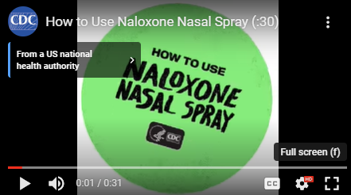
Know how to administer naloxone nasal sprays
CDC, 2023c. Retrieved from https://www.cdc.gov/stopoverdose/naloxone/index.html
Notes:
Discussion Points:
This video from CDC highlights how to use nasal naloxone.
Many of the formulations you may use will have similar instructions, though it’s important to follow manufacturer’s instructions when using naloxone.
In the next few slides, we will discuss how to administer the [presenter: insert which formulations you will discuss: generic naloxone, NARCAN, Kloxxado] nasal spray(s).
Note: the graphic on this slide hyperlinks to the video: https://youtu.be/odlFtGNjmMQ. You may also embed the video on the slide to facilitate your presentation. Customize the third bullet point accordingly.
Content and graphic (screenshot) source: https://www.cdc.gov/stopoverdose/naloxone/index.html

Slide 32
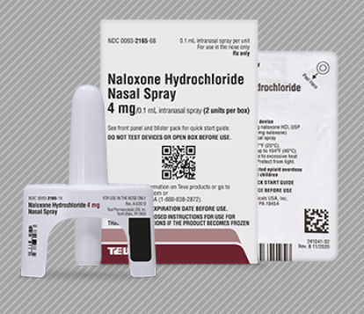
Generic Naloxone: Nasal Spray
Photo used with permission by Teva Pharmaceuticals
Notes:
Discussion Point:
Teva Pharmaceuticals manufactures a generic version of naloxone nasal spray (as pictured). Generic versions are also made by AMPHASTAR PHARMACEUTICALS INC and PADAGIS ISRAEL PHARMACEUTICALS LTD.
Image source: Teva Pharmaceauticals, https://www.tevanaloxone.com/

Slide 33
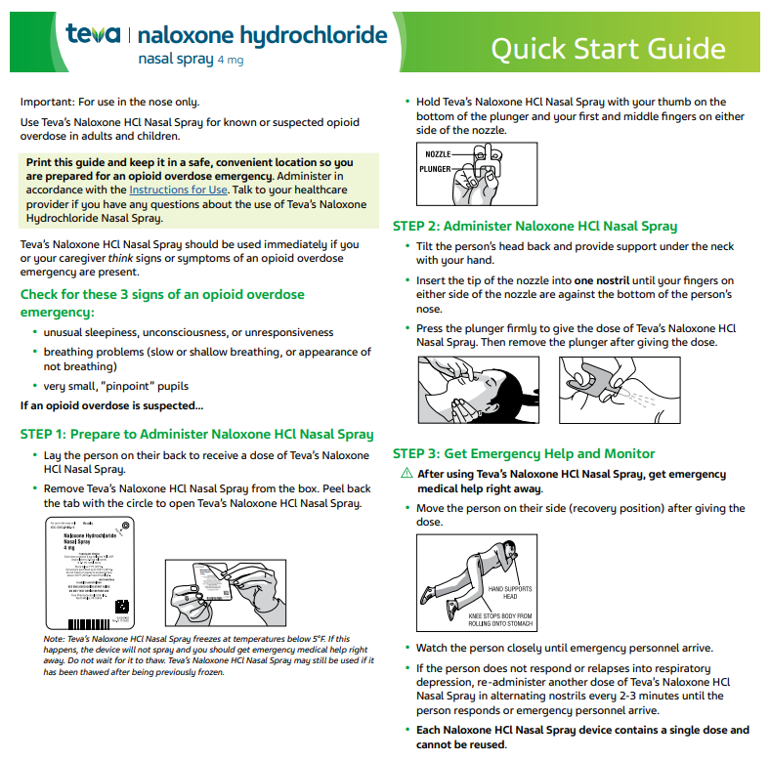
How to Administer Naloxone Nasal Spray (Generic)
Used with permission by Teva Pharmaceuticals
Notes:
Discussion Points:
This slide includes instructions for administering the generic naloxone nasal spray made by Teva.
The instructions closely mirror those in the video we just watched.
Content source: Teva Pharmaceuticals, https://www.tevanaloxone.com/globalassets/naloxone/pdfs/tg-42721_naloxone-hcl-nasal-spray-quick-start-guide_final.pdf

Slide 34
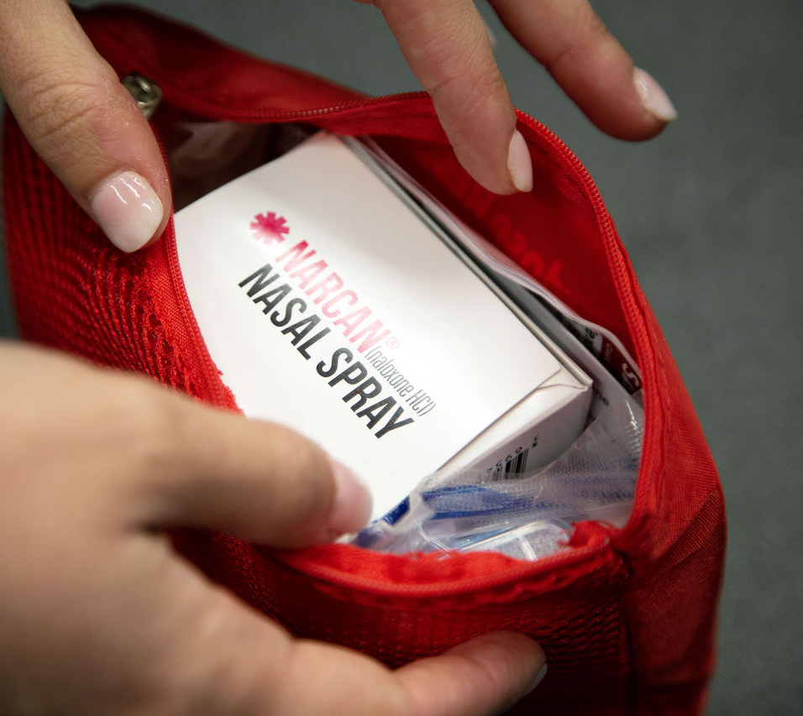
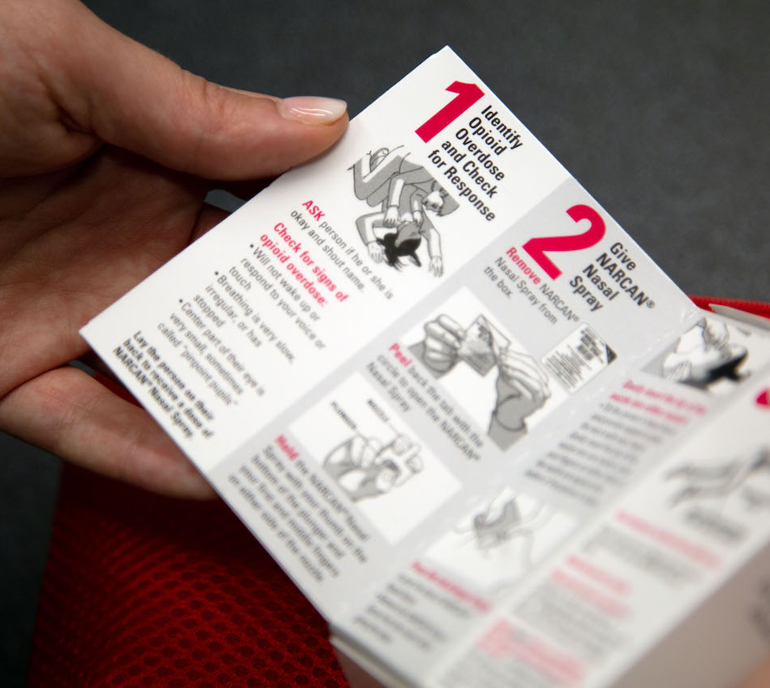
NARCAN: Nasal Spray
Images source: NIDA Flickr, https://www.flickr.com/photos/nida-nih/52566291708/in/album-72177720304478612/
Notes:
Discussion Point:
NARCAN is another form of naloxone nasal spray and likely one of the most recognizable brands.
Images source: NIDA Flickr, https://www.flickr.com/photos/nida-nih/52566291708/in/album-72177720304478612/

Slide 35
How to Administer NARCAN
Used with permission by ADAPT Pharma.
Notes:
Discussion Points:
These are the instructions on how to administer NARCAN nasal spray.
The instructions for use align with those presented in the video a few slides back.
Notes: A training video from NARCAN is available at: https://www.youtube.com/watch?v=KEOq6fUWNtA. This may also be used to support training school staff on use of NARCAN.
Graphic source: https://www.narcan.com/wp-content/uploads/2021/10/Gen2-Instructions-For-Use.pdf

Slide 36
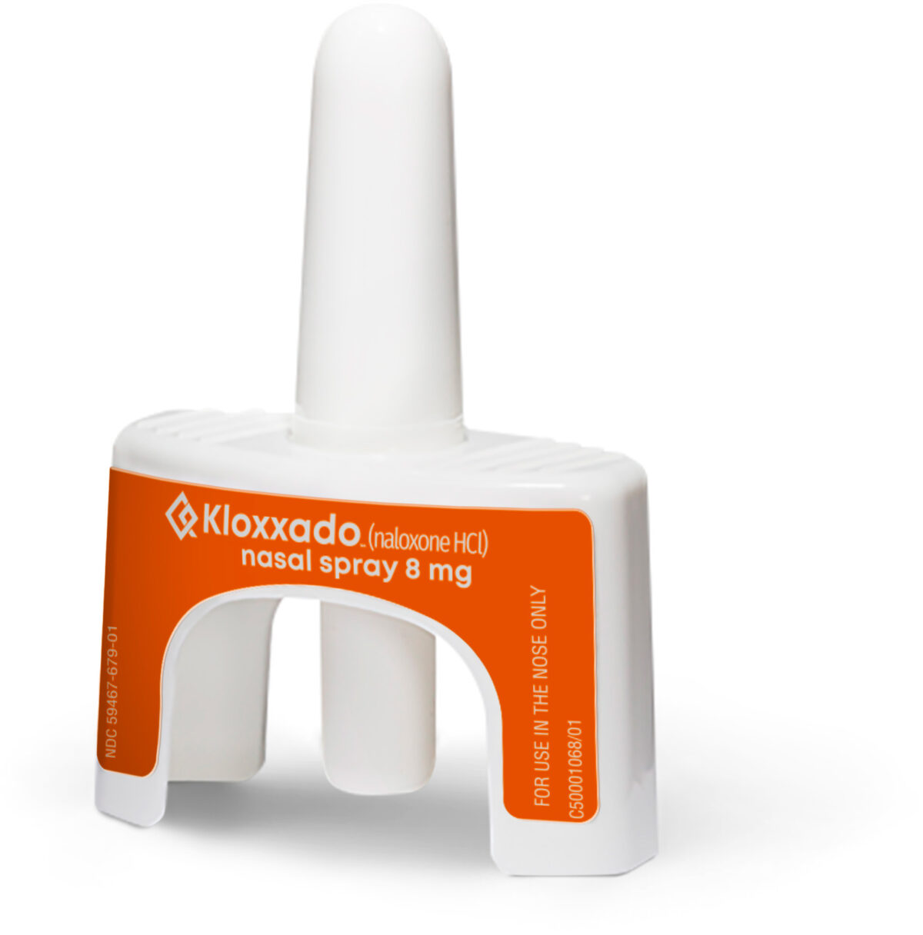
Kloxxado: Nasal Spray
Used with permission by Hikma Pharmaceuticals
Notes:
Discussion Point:
Kloxxado is another naloxone nasal spray brand.
Photo source: Hikma Pharmaceuticals, https://kloxxado.com/what-is-kloxxado/

Slide 37
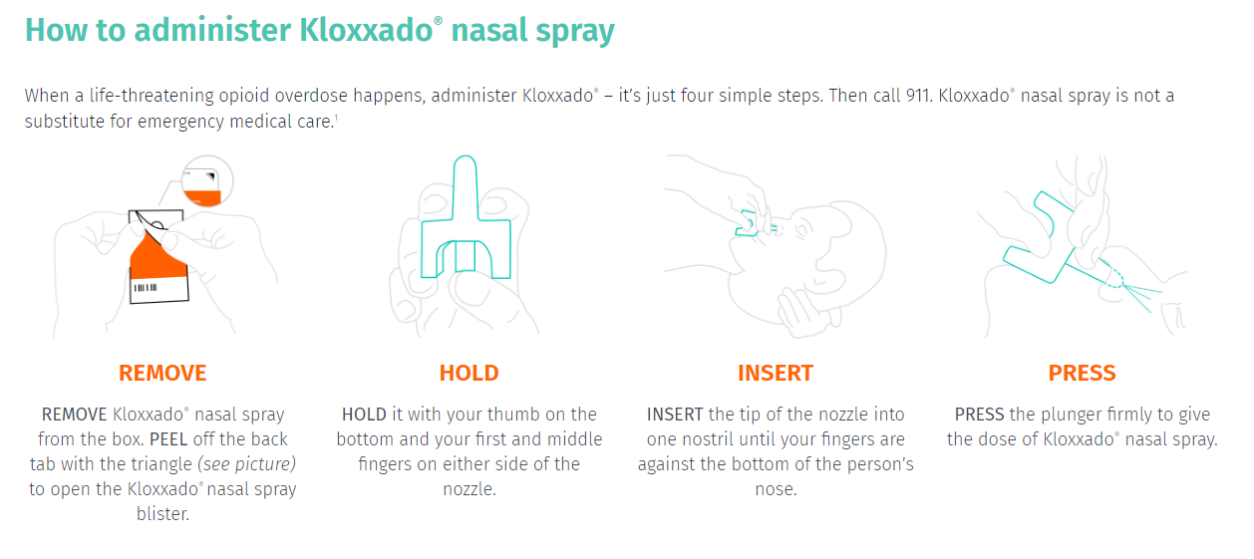
How to Administer Kloxxado
Used with permission by Hikma Pharmaceuticals
Notes:
Discussion Points:
These are the instructions on how to administer Kloxxado nasal spray.
The instructions for use are the same as those presented in the video on how to use naloxone nasal spray.
Graphic source: https://kloxxado.com/how-to-use/

Slide 38
Know How To Administer Naloxone Injectables
CDC, 2023d. Retrieved from https://www.cdc.gov/stopoverdose/naloxone/index.html
Notes:
Discussion Points:
This video from CDC highlights how to use injectable naloxone.
In the next few slides, we will discuss how to administer the [presenter: insert which formulations you will discuss: generic naloxone, Zimhi] injectable(s).
Notes:
The graphic (screenshot) on this slide hyperlinks to the video: https://youtu.be/zvVLygabkNA.
You may also embed the video on the slide to facilitate your presentation.
Zimhi is pronounced Zim-Hi.
Content and graphic (screenshot) source: https://www.cdc.gov/stopoverdose/naloxone/index.html

Slide 39
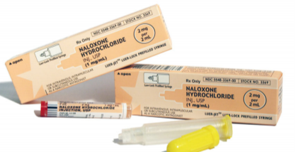
Generic Naloxone: Injection
Used with permission Amphastar Pharmaceuticals
Notes:
Discussion Point:
Amphastar pharmaceuticals offers a generic version of naloxone nasal spray.
Image source: Amphastar Pharmaceuticals, 2016 - https://amphastar.com/assets/naloxone_9-182.pdf

Slide 40
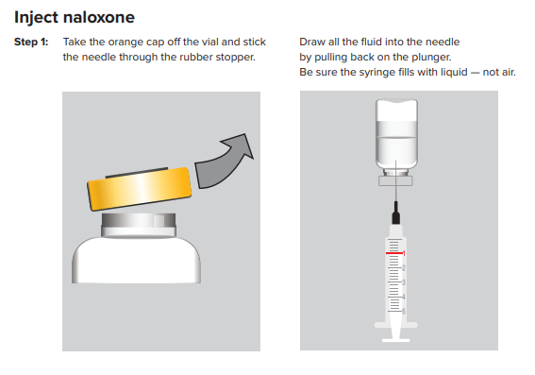
How to Administer Generic Naloxone (Injection)
Notes:
Discussion Point:
These are the instructions on how to administer the naloxone injection, which mirror those presented in the video we just watched.
Note: read through step 1.
Image source: https://www.health.ny.gov/publications/0161.pdf

Slide 41
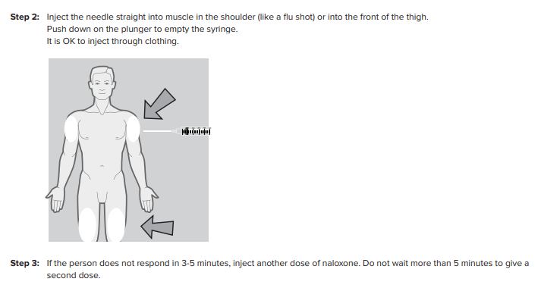
How to Administer Generic Naloxone (Injection)
Notes:
Discussion Point:
These are the instructions on how to administer the naloxone injection, which mirror those presented in the video we just watched.
Notes: read through steps 2 – 3.
Image source: https://www.health.ny.gov/publications/0161.pdf

Slide 42
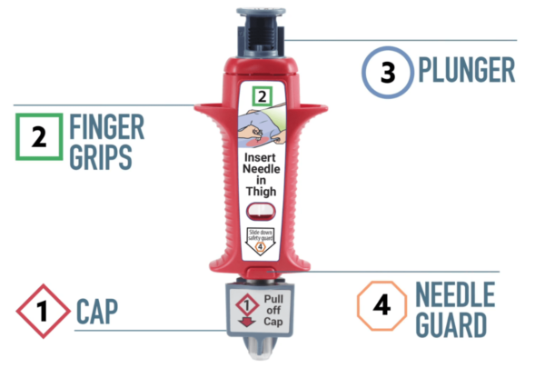
ZIMHI: Auto Injection
Used with permission by Adamis Pharmaceuticals
Notes:
Discussion Point:
An auto injection, ZIMHI, is also available without assembly.
Photo source: https://zimhi.com/patients-and-caregivers/how-to-use-zimhi/

Slide 43
How to administer ZIMHI (injectable naloxone)
Used with permission by Adamis Pharmaceuticals
Notes:
Discussion Point:
These are the instructions on how to administer ZIMHI.
Notes: Read through each of the four steps listed (press, push, pull, place). You may also choose to show a video on how to use ZIMHI: The video is located on the ZIMHI homepage: https://zimhi.com.
Image source: https://zimhi.com/wp-content/uploads/2022/09/ZIMHI_Instructions-for-Use.pdf

Slide 44
How to Respond to an Overdose: Recognize Respond Reverse Respirations Refer
Figure 32: Picture of a life saver ring in water retrieved fromhttps://blog.disabilitycanhappen.org/how-to-build-an-emergency-fund/
Notes:
Discussion Point:
After administering naloxone, assess the person’s breathing.
Source: https://store.samhsa.gov/sites/default/files/d7/priv/sma18-4742.pdf

Slide 45
Perform Rescue Breathing
How to Perform Rescue Breathing (if needed)
Place the person on their back.
Tilt their chin up to open the airway.
Check to see if there is anything in their mouth blocking their airway, such as gum, a toothpick, undissolved pills, syringe cap, cheeked Fentanyl patch.
If present, remove it.
Tilt their chin up to open the airway.
If using a mask, place and hold mask over mouth and nose.
If not using mask, pinch their nose with one hand and place your mouth over their mouth to make a seal.
Give 2 even, regular-sized breaths.
Blow enough air into their lungs to make their chest rise.
If you are using a mask and don’t see their chest rise, out of the corner of your eye, tilt the head back more and make sure the seal around the mouth and nose is secure.
If you are not using a mask and don’t see their chest rise, out of the corner of your eye make sure you’re pinching their nose.
Breathe again.
Give one breath every 5 seconds.
Notes:
Discussion Point:
To support respiration, give CPR if you have been trained or perform rescue breathing, if needed.
Notes
Walk through slide content on rescue breathing, if needed for your audience.

Slide 46
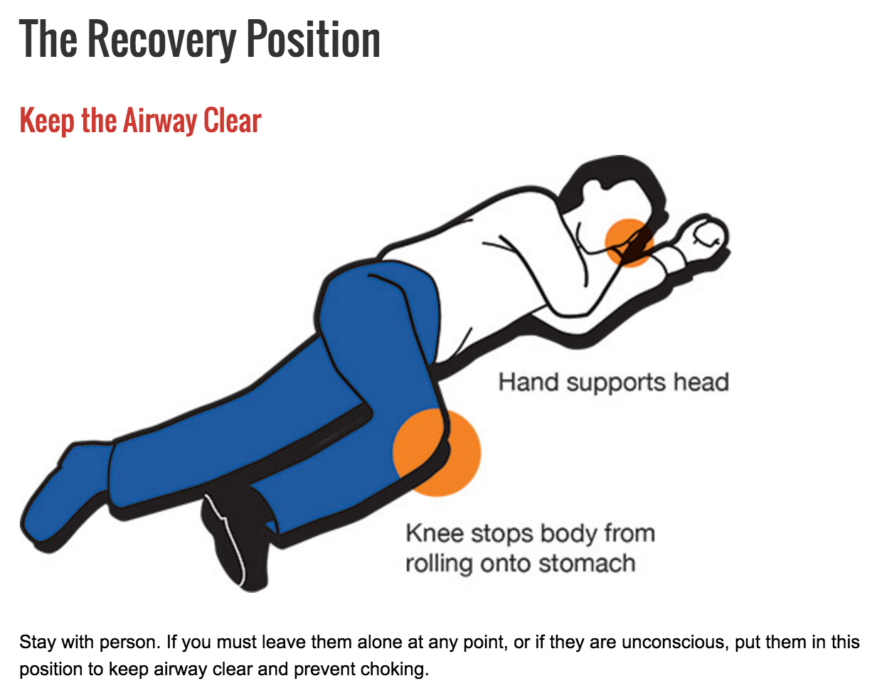
Recovery Position
Place person in recovery position – if you need to leave the person unattended
Stay with the person until help arrives
Remove opioids found on the person and process in accordance with school district protocols (SAMSHA, 2023a)
Notes:
Discussion Points:
If you need to leave the person unattended for any reason, be sure to place the person in the recovery position.
Place the person on their side
Place their hands under their head to support it
Bring their top leg forward with their knee bent to stop their body from rolling onto their stomach.
After administering naloxone, stay with the person until help arrives and be sure to remove any opioids found on the person and process them according to school district protocols.
Content Sources:
https://store.samhsa.gov/sites/default/files/d7/priv/sma18-4742.pdf
Image source (screenshot):
-https://www.firstaidforfree.com/what-is-the-recovery-position-in-first-aid

Slide 47
How to Respond to an Overdose: Recognize Respond Reverse Respirations Refer
Figure 34: Picture of a life saver ring in water retrieved fromhttps://blog.disabilitycanhappen.org/how-to-build-an-emergency-fund/
Notes:
Discussion Point:
After naloxone is administered, it is important to monitor the person’s response and REFER them to a medical facility.

Slide 48
Refer and Monitor
Transport to a medical facility
Contact parents or legal guardians
Complete Naloxone Administration Report form
Follow up with treatment referral recommendations
Notes:
Discussion Points:
Have the individual transported to nearest medical facility, even if symptoms seem to get better.
Contact parents or legal guardians per school protocol.
Complete Naloxone Administration Report form, if part of school protocol.
Follow up with treatment referral recommendations.

Slide 49
How Will I Know What to Do?
[Insert school name] will develop/maintain a naloxone administration protocol.
The protocol includes steps to follow in the event of an opioid overdose, and it will be reviewed regularly.
Opioid Overdose Response Protocol by NASN
Notes:
Notes: Customize this slide by adding your school’s name. Remove “develop” or “maintain” depending on whether your school is developing or has already developed (is maintaining) a naloxone administration protocol.
Image source: NASN Naloxone Toolkit

Slide 50
Good Samaritan Laws

Slide 51
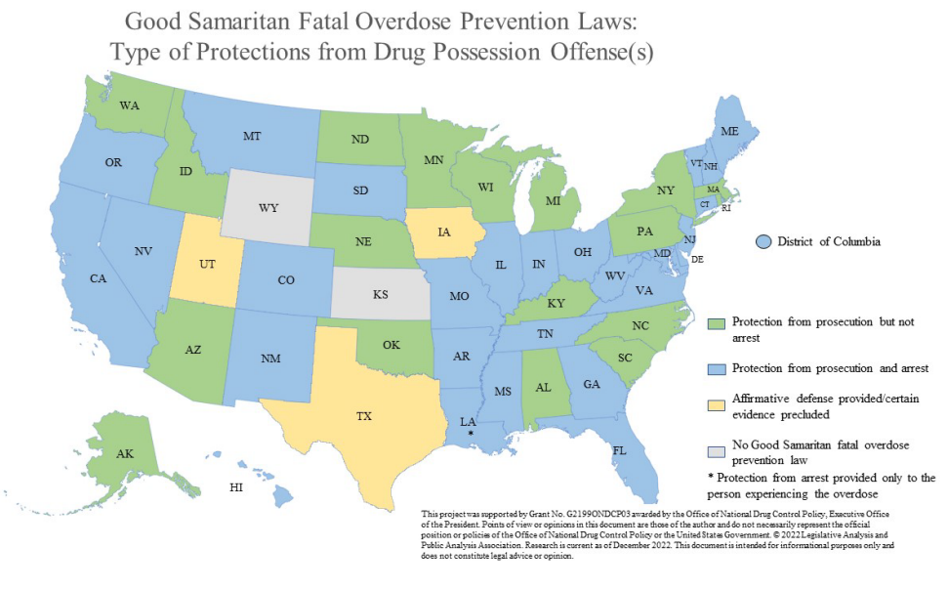
Good Samaritan Laws
Protects people from prosecution or arrest if they call 911 to save someone experiencing an overdose.
These laws may also protect the person who is experiencing an overdose. (Legislative Analysis and Public Policy Association, 2022)
(Legislative Analysis and Public Policy Association, 2022)
Notes:
Discussion Points:
How do state good Samaritan laws affect naloxone in schools programs?
As of December 2022, 47 states and the District of Columbia have Good Samaritan fatal overdose prevention laws. Only Kansas and Wyoming do not have such laws. Additionally, none of the other U.S. territories has a Good Samaritan fatal overdose prevention law in place.
States have implemented laws to make it easier for first responders and the general public to obtain naloxone (for example, making formulations available over the counter). Additionally, to encourage people to assist an individual who is or may be experiencing an overdose, most states also enacted laws which protect laypeople who administer naloxone, in good faith, in an emergency from civil and/or criminal liability. The Legislative Analysis and Public Policy Association (LAPPA) undertook an extensive research project to determine the current status of naloxone access laws throughout the United States, including the District of Columbia and all U.S. territories. As of August 2020, all 50 states and the District of Columbia have some form of a naloxone access law. The laws vary significantly by state.
Content sources:
http://legislativeanalysis.org/wp-content/uploads/2022/12/Good-Samaritan-Fatal-Overdose-Prevention-And-Drug-Induced-Homicide-Summary.pdf
https://legislativeanalysis.org/naloxone-summary-of-state-laws/
Graphic source: http://legislativeanalysis.org/wp-content/uploads/2022/12/Good-Samaritan-Fatal-Overdose-Prevention-And-Drug-Induced-Homicide-Summary.pdf

Slide 52
Questions?

Slide 53
Thank you!
PRESENTER NAME
CONTACT INFORMATION
Notes:
Notes: Add your name and contact information here and any other resources.

Slide 54
References
Adamis Pharmaceuticals Corp. (2022). How to use Zimhi image. https://zimhi.com/wp-content/uploads/2022/03/
ZIMH-Prescribing-Information.pdf
Amphastar Pharmaceuticals, 2016. Generic Naloxone injection image. https://amphastar.com/assets/naloxone_9-182.pdf
Baazi, A.R., et al. “Preventing Opiate Overdose Deaths: Examining Objections to Take-Home Naloxone”Journal of
Health Care for the Poor and Underserved, vol 21, no. 4, 2010.
Centers for Disease Control and Prevention. (2022). Stop overdose—fentanyl test strips: A harm reduction strategy. https://www.cdc.gov/drugoverdose/deaths/2020.html
Centers for Disease Control and Prevention. (2023a) Overdose Graphics. https://www.cdc.gov/drugoverdose/resources/graphics/overdose.html
Centers for Disease Control and Prevention. (2023b) Fentanyl Facts. Retrieved from https://www.cdc.gov/stopoverdose/fentanyl/index.html
Centers for Disease Control and Prevention. (2023c) How to Use Naloxone Nasal Spray. Retrieved from https://www.cdc.gov/stopoverdoes/naloxone/index.html
Centers for Disease Control and Prevention. (2023d) How to Use Injectable Naloxone. Retrieved from https://www.cdc.gov/stopoverdoes/naloxone/index.html
Centers for Disease Control and Prevention. (2023e) Synthetic Opioid Overdose Data. Retrieved from https://www.cdc.gov/drugoverdose/deaths/synthetic/index.html
Centers for Disease Control and Prevention. (2023f). Preventing an Opioid Overdose. Retrieved from https://www.cdc.gov/drugoverdoes/pdf/patients/preventing-an-opoid-overdose-tip-card-a.pdf
Centers for Disease Control and Prevention. (2023g) Life Saving Naloxone. Retrieved from https://www.cdc.gov/stopoverdose/naloxone/index.html
Centers for Disease Control and Prevention (CDC), National Center for Health Statistics (NCHS). (2023). Multiple cause of deaths 1999-2021. WONDER Online Database. https:..wonder.cdc.gov/mcd.html
Enteen L, Bauer J, McLean R, et al. Overdose prevention and naloxone prescription for opioid users in San Francisco. J Urban Health. 2010;87(6):931-941. doi:10.1007/s11524-010-9495-8
Hikma Pharmaceuticals USA Inc. (2023). Kloxxxado nasal spray image. https://kloxxado.com/what-is-kloxxado/

Slide 55
References
Jones, J.D., et al. “No Evidence of Compensatory Drug Use Risk Behavior among Heroin Users after Receiving Take-Home Naloxone.” Addictive Behaviors, vol. 71, 2017, pp.104-106.
Legislative Analysis and Public Policy Association. (2022) Good Samarititan Fatal Overdose Prevention and Drug Indiced Homicide: Summary of State Laws.
Massachusetts Department of Public Health. (n.d.) Opioid Overdose Education and Naloxone Distribution: MDPH Naloxone Pilot Program and Core Competencies. Retrieved from https://www.mass.gov/doc/core-competencies-for-intra-nasal -
naloxone-distribution-pilot-program-participants/download
Miech, R.S., Johnston, L.D., Patrick, M.E., O’Malley, P.M., Bachman, J.G., & Schulenberg, J.E. (2023). Monitoring the Future national survey results on drug use, 1975-2022: Secondary school students. Institute for Social Research,
National Institute on Drug Abuse, National Institutes of Health (NIDA). 2021a. Presecription Opoids DrugFacts. Retrieved from https://nida.nih.gov/publications/drugfacts/prescription-opioids.
National Institute on Drug Abuse, National Institutes of Health (NIDA). (2021b). Fentanly DrugFacts. Publications. https://nida.nih.gov/publications/drugfacts/fentanyl
National Institute on Drug Abuse, National Institute of Health (NIDA). (2022). Naloxone DrugFacts. Publications. https://nida.nih.gov/publications/drugfacts/naloxone
National Institute on Drug Abuse, National Institute of Health (n.d.a) Opioids. Retrieved from
https://nida.nih.gov/research topics/opioids
National Institute on Drug Abuse, National Institute of Health (n.d.b.) Commonly Used Drug Charts. Retrieved from https://nida.nih.gov/research-topics/commonly-used-drugs-charts#prescription-opioids
National Institute on Drug Abuse, National Institute of Health (2023a) Prescription Opioids Drug Facts. Retrieved from https://nida.nih.gov/publications/drugfacts/prescription-opioids
National Institute of Drug Abuse, National Institute of Health (2023b) Drug Overdose Death Rates. Retrieved from https://nida.nih.gov/research-topics/trends-statistics/overdose-death-rates
National Institute of Drug Abuse, National Institute of Health (2023c) Parents and Educators. Retrieved from https://nida.nih.gov/research-topics/parents-educators

Slide 56
References
National Institute of Drug Abuse, National Institute of Health (2023d) Naloxone Drug Facts. Retrieved from https://nida.nih.gov/publications/drugfacts/naloxone
National Institute of Drug Abuse, National Institute of Health (2023e) Xylazine. Retrieved from
https://nida.nih.gov/research-topics/xylazine
National Institute of Neurological Disorders and Stroke. (2023) Cerebral Hypoxia. Retrieved from https://www.ninds.nih.gov/health-information/disorders/cerebral-hypoxia
National Library of Medicine. (2017) Emergency Medical Service Response Times In Rual, Suburban, and Urban Areas. JAMA
Surgery 2017Juy 19.DOI: 10.1001/jamasurg.2017.2230. Retrieved from https://www.ncbi.nlm.nih.gov/pmc/articles/PMC5831456/
Substance Abuse and Mental Health Services Administration. Department of Health and Human Services. (2023a) SAMSHA- Opioid Overdose Prevention Toolkit. Retrieved https://store.samhsa.gov/sites/default/files/d7/priv/sma18 4742.pdf
Substance Abuse and Mental Health Services Administration. Department of Health and Human Services. (2023b) SAMSHA- Opioid Overdose Prevention Toolkit- Five essential Steps for Responders. Retrieved from https://store.samhsa.gov/sites/default/files/d7/priv/five-essential-steps-for-first-responders.pdf
Tanz LJ, Dinwiddie AT, Mattson CL, O’Donnell J, Davis NL. Drug Overdose Deaths Among Persons Aged 10–19 Years — United States, July 2019–December 2021. MMWR Morb Mortal Wkly Rep 2022;71:1576–1582.
DOI: http://dx.doi.org/10.15585/mmwr.mm7150a2.
Wagner, K.D., et al. “Evaluation of an Overdoes Prevention and Responses Training Programme for Injection Drug Users in the Skid Row Area of Los Angeles, CA”. International Journal
Walley AY, Xuan Z, Hackman HH, et al. Opioid overdose rates and implementation of overdose education and nasal naloxone distribution in Massachusetts: interrupted time series analysis. BMJ. 2013;346:f174.
U.S. Food and Drug Administration. (2023a) FDA Alerts Healthcare Professionals of Risks to Patients Exposed to Xylazine. Retrieved from https://www.fda.gov/drugs/drug-safety-and-availability/fda-alerts-health-care-professionals-risks
-patients-exposed-xylazine-illicit-drugs
U.S. Food and Drug Administration. (2023b) Safe Opioid Disposal: Remove the Risk Outreach Toolkit. Retrieved from https://www.fda.gov/drugs/safe-disposal-medicines/safe-opioid-disposal-remove-risk-outreach-toolkit

